Slide 1
Warm Up #4

Slide 2
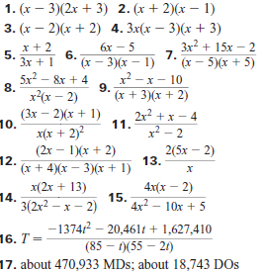
Homework Check

Slide 3
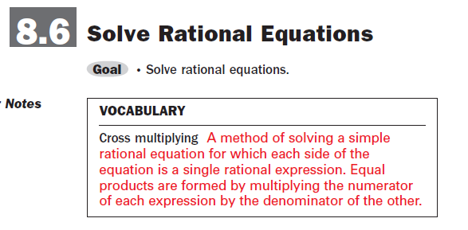
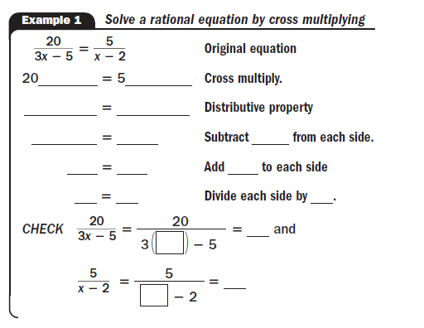

Slide 5
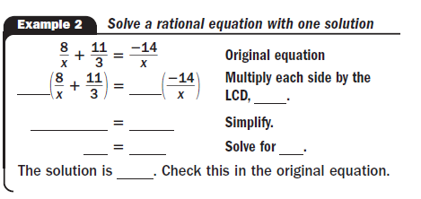
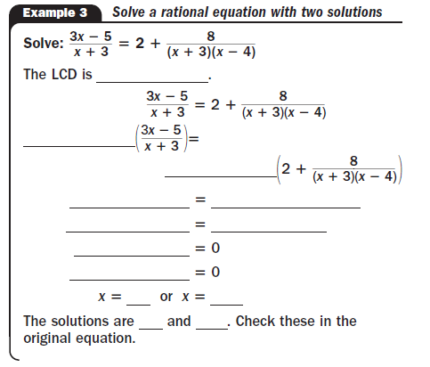

Slide 9
Classwork
Practice WS 8.6
#1 – 17 0dd, 19 – 22 all

