Slide 1
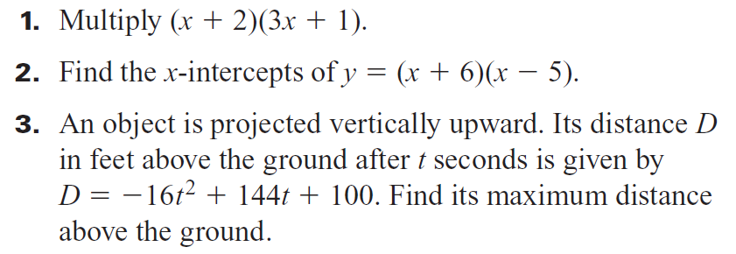
Warm Up #4
ANSWER

Slide 2
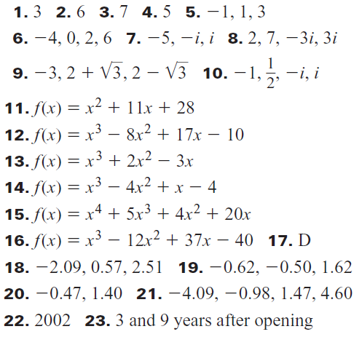
Check HW 5.7

Slide 6
Since the term (x + 1) is to the second power(even power), it touches the x-axis without passing through. That is what a double root looks like on a graph. This is cubic – lazy s shape – positive leading coefficient – ends up going up.

Slide 7
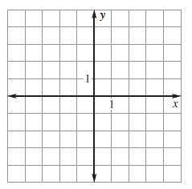
y= -3(x – 3)(x – 1)(x +2)²
Quartic – w or m ??? Up or down???

Slide 8
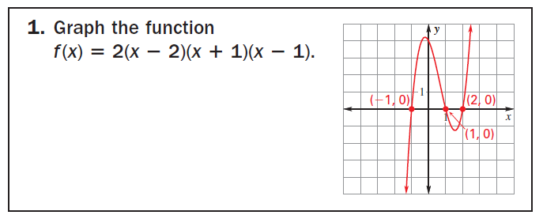
Graph the intercepts, it is cubic – lazy s – positive leading coefficient – ends up going up. Make a quick sketch!

Slide 9
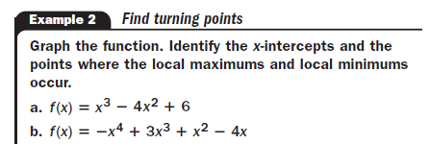
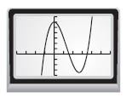
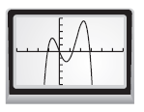
A.
B.

Slide 13
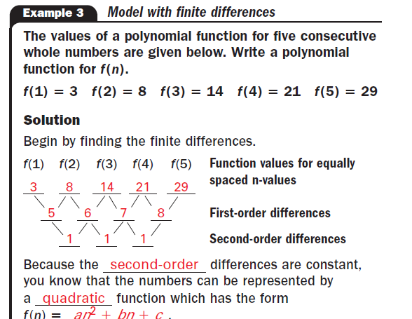
Use the calculator – Stat Edit – x in L1 and y in L2 – STAT Calc Quad Reg

Slide 14
1 4 13 34 73 136

Slide 15
Find the equation using finite differences.
f(-3) =213, f(-2) = 25, f(-1) = -7, f(0) = -3, f(1) = -11, f(2) = -7, f(3) = 205

Slide 16
Homework
Practice workbook
5.8 # 1 – 27 odd
5.9 # 1, 5, 7, 10, 11

