Slide 1

Warm Up #2
A
b
c
C
B
a
$$\frac{3}{\sqrt{34}}$$
$$\frac{5}{\sqrt{34}}$$

Slide 2
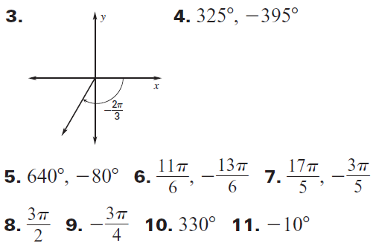
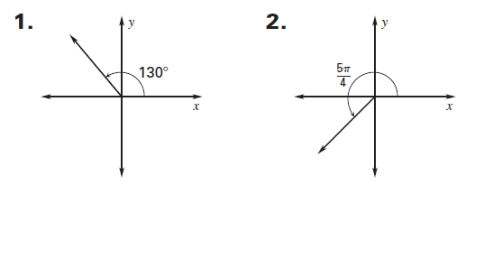
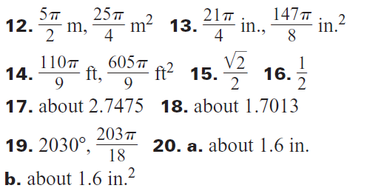
HOMEWORK CHECK

Slide 6
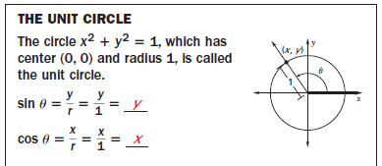

Slide 8
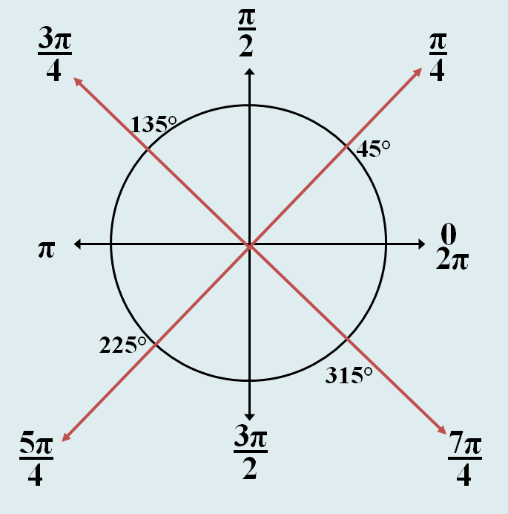
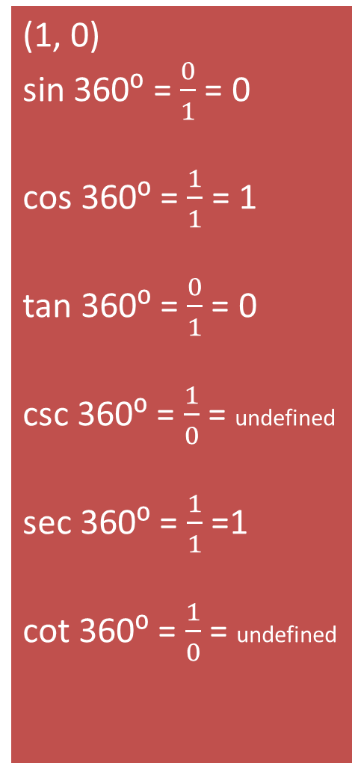
(1, 0)
sin 360⁰ = $\frac{0}{1}$ = 0
cos 360⁰ = $\frac{1}{1}$ = 1
tan 360⁰ = $\frac{0}{1}$ = 0
csc 360⁰ = $\frac{1}{0}$ = undefined
sec 360⁰ = $\frac{1}{1}$ =1
cot 360⁰ = $\frac{1}{0}$ = undefined

Slide 9
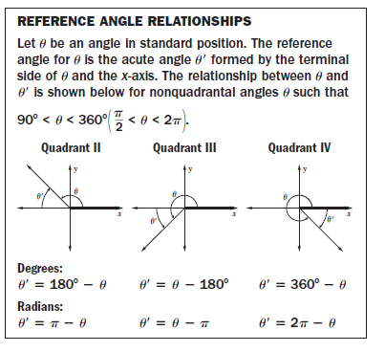

Slide 10
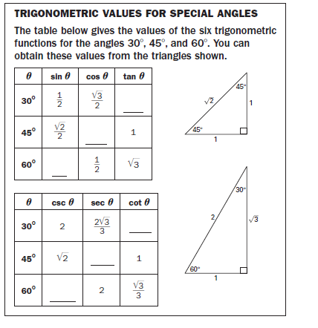
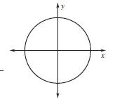
You should know Sine, Cosine , and Tangent of the quadrantal angles

Slide 11
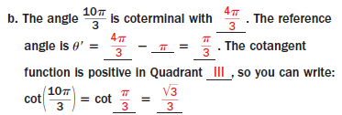

Slide 12
Homework
PW 13.3 #1-19 odd

